Slide 1

CSE360-Computer Interfacing BRAC University
Serial and Parallel Interface

Slide 2
Computer - Ports
A port is a physical docking point using which an external device can be connected to the computer. It can also be programmatic docking point through which information flows from a program to the computer or over the Internet.
A port has the following characteristics −
External devices are connected to a computer using cables and ports.
Ports are slots on the motherboard into which a cable of external device is plugged in.
Examples of external devices attached via ports are the mouse, keyboard, monitor, microphone, speakers, etc.

Slide 3
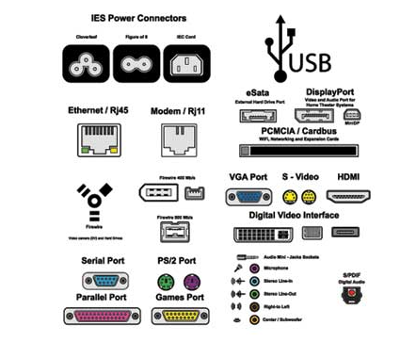
Let us now discuss a few important types of ports −
Serial Port
Parallel Port
PS/2 Port
USB Port
VGA Port
Power Connector
Firewire
Modem Port
Ethernet Port
Game Port
DVI Port
Socket
Figure: Different types of ports

Slide 4
Serial and Parallel Ports
All interface elements, from your keyboard to your mouse, eventually transport digital information from the external world to the CPU. There are two obvious ways to do this –
1) Serial 2) Parallel Communication
Here Serial ports and parallel ports are used for Serial and Parallel communication respectively.

Slide 5
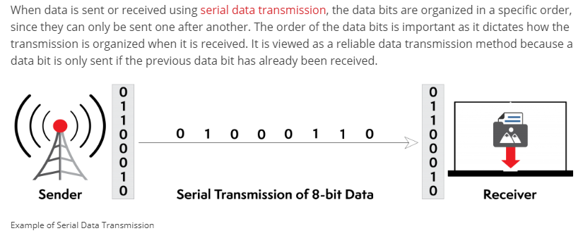
Serial Transmission

Slide 6
Serial Transmission
When is serial transmission used to send data?
Serial transmission is normally used for long-distance data transfer. It is also used in cases where the amount of data being sent is relatively small. It ensures that data integrity is maintained as it transmits the data bits in a specific order, one after another. In this way, data bits are received in-sync with one another.

Slide 7
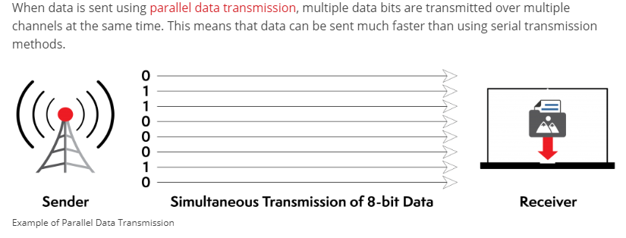
Parallel Transmission
This communication comes for rescue when speed rather than space is the main objective. The transfer of data is at high speed owing to the fact that no bus buffer is present.

Slide 8
Serial and Parallel Ports
2) Parallel communication transfers 8, 16, or 32 bits one each clock pulse.
Clearly this is much faster, but it requires many simultaneous data lines.
This is really the only choice for very fast processes, like sending data from the CPU to external Random Access Memory (RAM).
The number of data lines could quickly become ridiculous if you have many separate devices that communicate with the CPU. .

Slide 9
Why Serial Communication is slower than parallel?
For a 8 bit data transfer in Serial communication one bit will be sent at a time. The entire data is first fed into the serial port buffer. From this buffer one bit will be sent at a time. Only after the last bit is received the data transferred can be forwarded for processing. While in the Parallel Communication a serial port buffer is not required. According to the length of the data, the number of bus lines are available plus a synchronization line for synchronized transmission of data.
Thus we can state that for the same frequency of data transmission Serial communication is slower than parallel communication

Slide 10
Why Serial Communication is preferred over parallel?
While parallel communication is faster when the frequency of transmission is same, it is cumbersome when the transmission is long distance. Also with the number of data channels it should also have a synchronous channel or a clock channel to keep the data synchronized.
In Serial the data is sent sequentially and latched up at the receiving end thus procuring the entire data from the data bus using USART/UART (Universal Synchronous Asynchronous Receiver Transmitter) without any loss in synchronization but in parallel even if one wire takes more time to recover the received data will be faulty.

Slide 11
Why Serial Communication is preferred over parallel?
The length of the wire for parallel interface is usually small. It is due to a phenomenon called crosstalk. “In electronics, crosstalk is any phenomenon by which a signal transmitted on one circuit or channel of a transmission system creates an undesired effect in another circuit or channel.”
Parallel transmission requires multiple lines to send data. There are fewer errors and less noise in serial transmission, since the transmission is done one bit at a time. There are more errors and noise in parallel transmission, since the transmission is done multiple bits at a time.

Slide 12
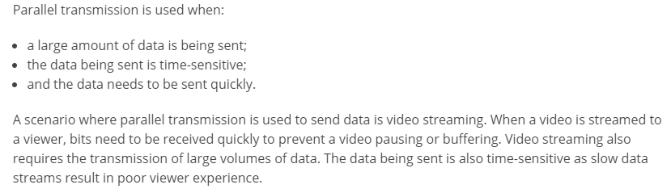
When Parallel Communication is used?

Slide 13
Examples
Examples of parallel mode transmission include connections between a computer and a printer (parallel printer port and cable). Most printers are within 6 meters or 20 feet of the transmitting computer and the slight cost for extra wires is offset by the added speed gained through parallel transmission of data.
Examples of serial mode transmission include connections between a computer and a modem using the RS-232 protocol . Although an RS-232 cable can theoretically accommodate 25 wires, all but two of these wires are for overhead control signaling and not data transmission; the two data wires perform simple serial transmission in either direction. In this case, a computer may not be close to a modem, making the cost of parallel transmission prohibitive—thus speed of transmission may be considered less important than the economical advantage of serial transmission

Slide 14
The End

